Slide 1



Ultra-Low Power Gesture Recognition System
Bryce Kellogg, Vamsi Talla, Shyam Gollakota

Slide 2
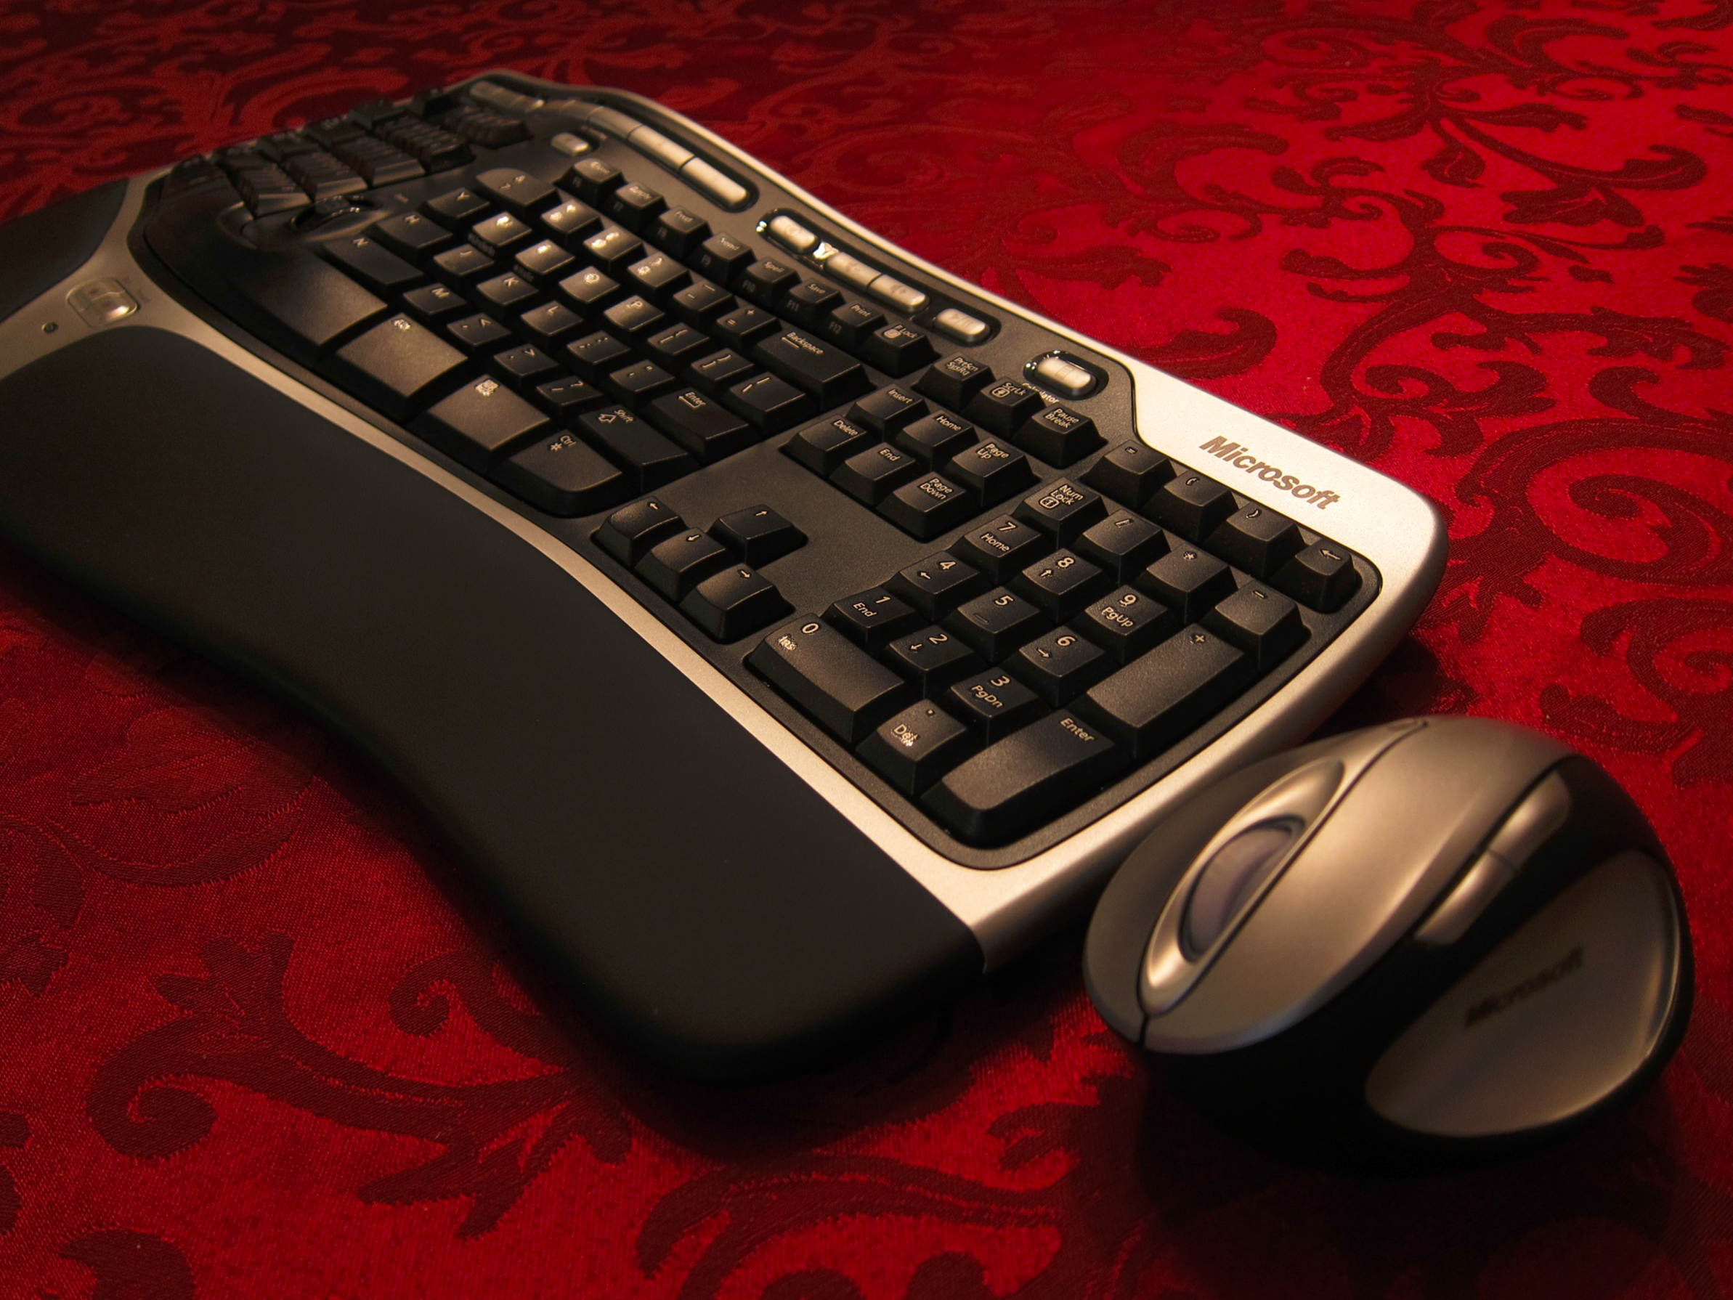
Beyond Mouse and Keyboard

Slide 3
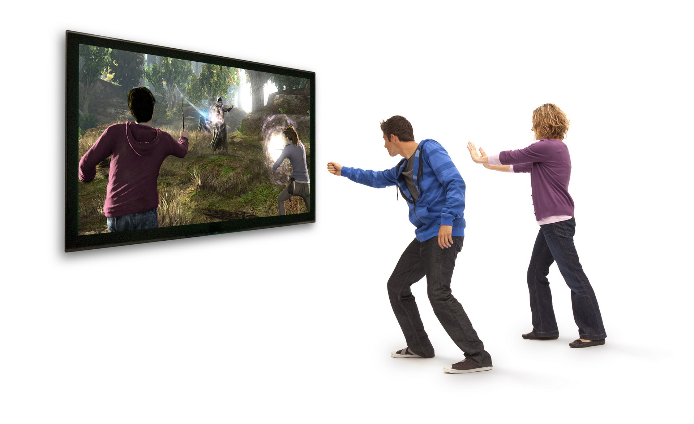
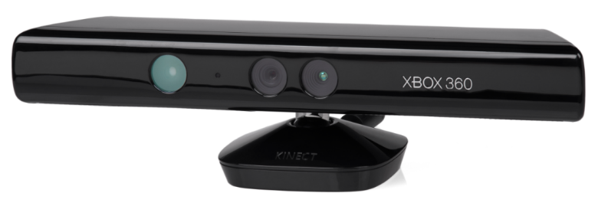
New Forms of Interaction
Limited to line of sight and
requires significant power

Slide 4
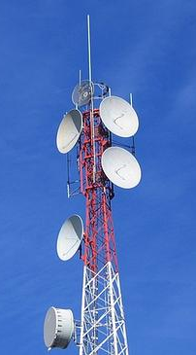
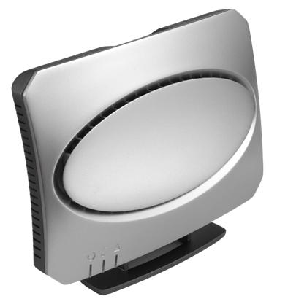
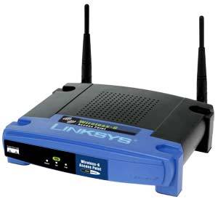
Our Idea
TV
Cellular
Wi-Fi
Leverage changes in ambient signals for always on gesture recognition

Slide 5
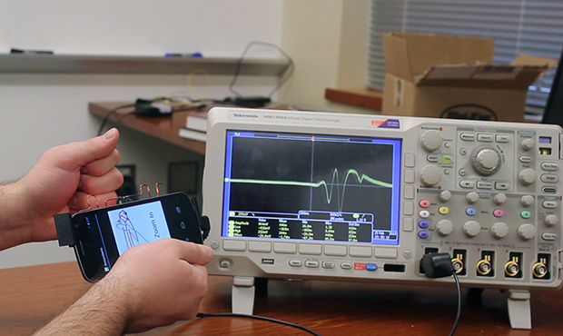
AllSee
First gesture system that runs without batteries
Leverages ambient TV and RFID signals
3 – 4 orders of magnitude less power
Integrated with mobile phones
Works through pockets

Slide 6
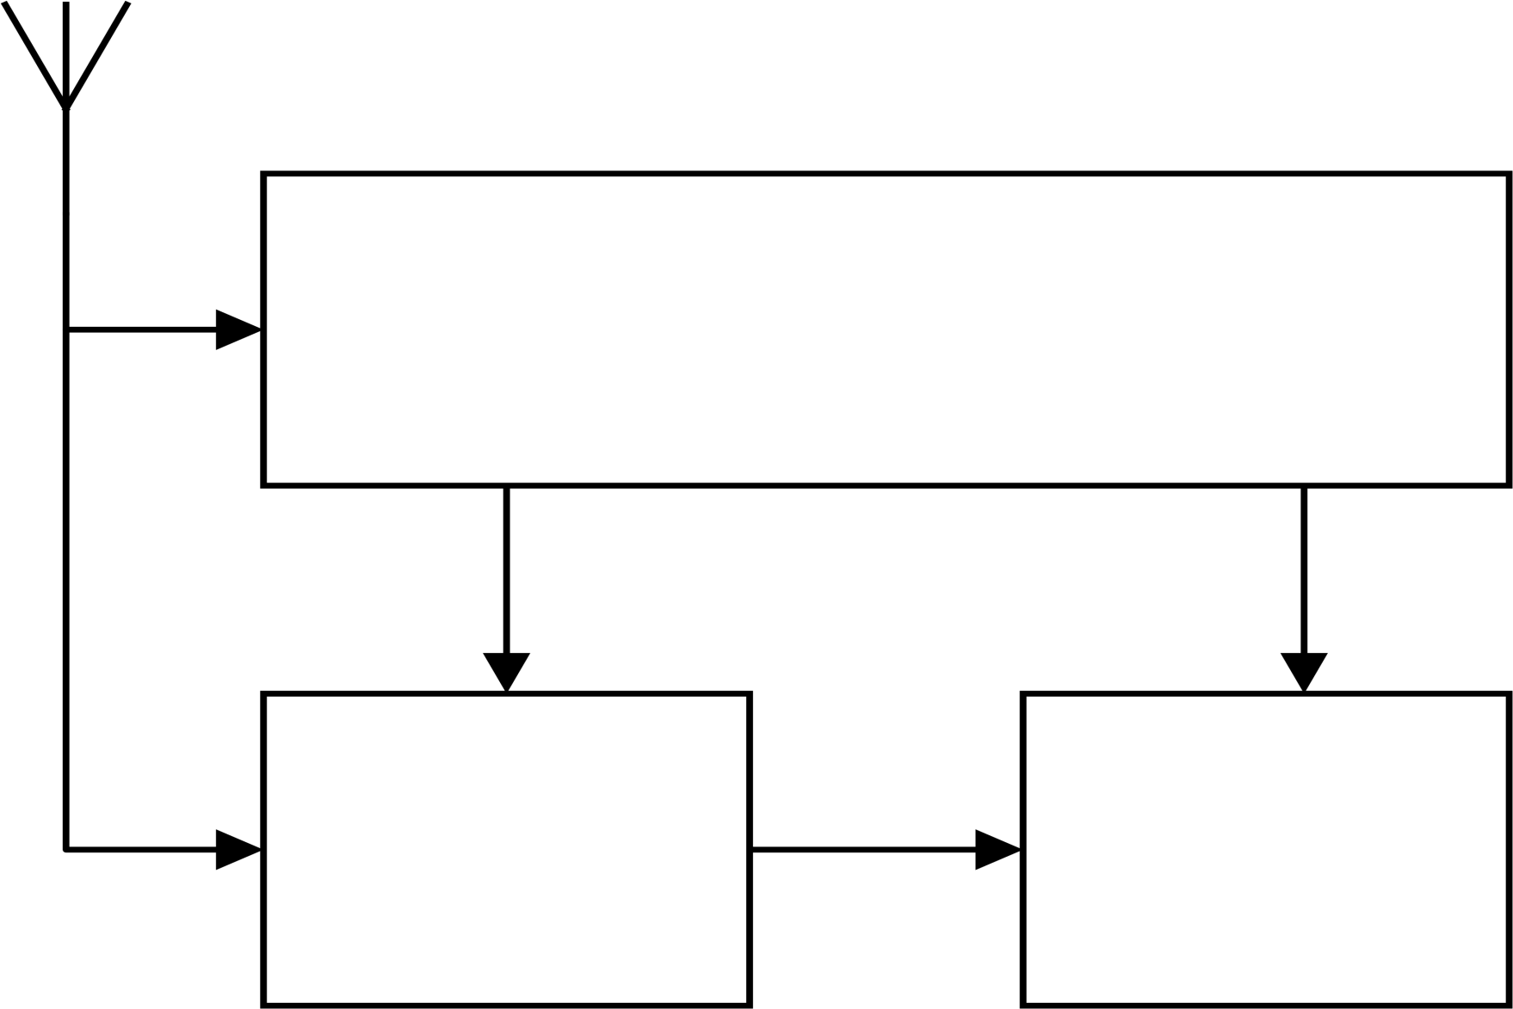
AllSee Hardware Architecture
Antenna
40 µW
RF Energy Harvester
Wireless
Receiver
Digital Logic
(MSP430)

Slide 7
AllSee Hardware Architecture
Antenna
40 µW
RF Energy Harvester
Wireless
Receiver
Digital Logic
(MSP430)

Slide 8
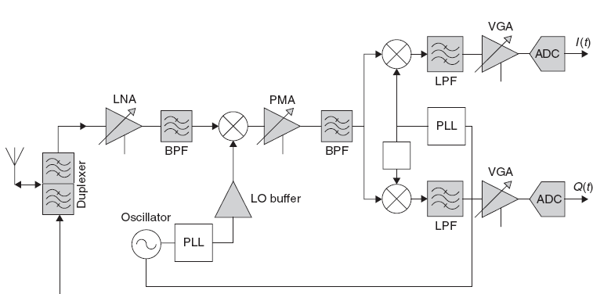
Challenge: Radios Drain Batteries
Consumes > 100 mW of power
Impractical for always on gestures

Slide 9
How do we access wireless signals without traditional radios?

Slide 10
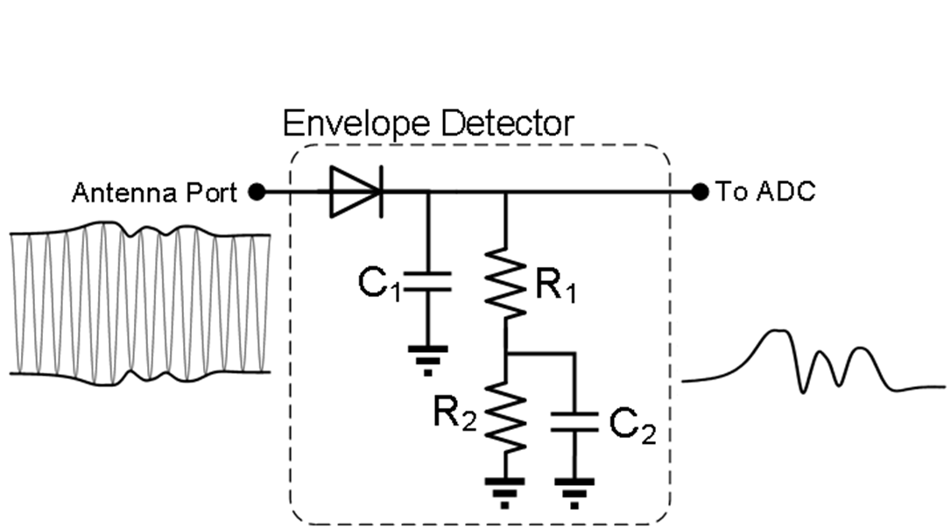
Solution: Ambient Backscatter Receiver
Uses only passive components
Amplitude
Zero power consumption

Slide 11
AllSee Hardware Architecture
Antenna
40 µW
RF Energy Harvester
Wireless
Receiver
Digital Logic
(MSP430)

Slide 12
AllSee Hardware Architecture
Antenna
40 µW
RF Energy Harvester
Wireless
Receiver
Digital Logic
(MSP430)

Slide 13
Challenge: Designing Low-Power Classifier
Our receiver only provides amplitude
- Prior solutions use phase (Doppler, AoA)
Can’t run computationally intensive operations
- No machine learning or even multiplication

Slide 14
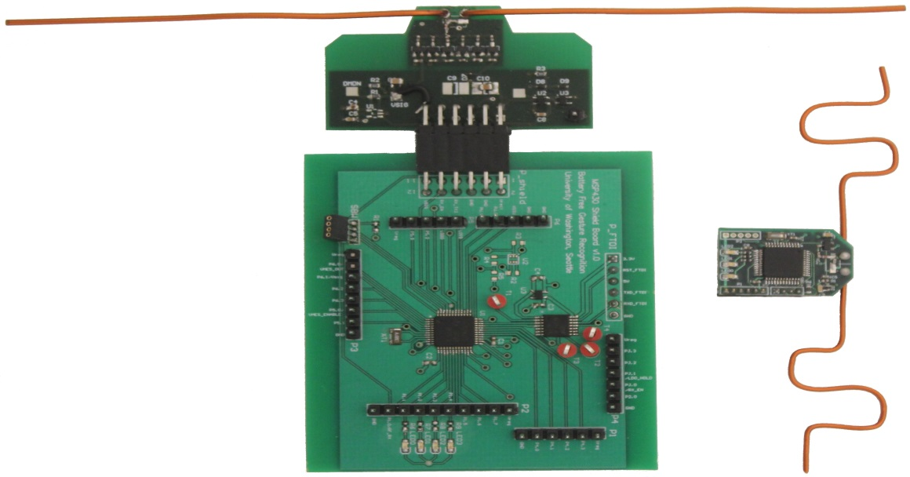
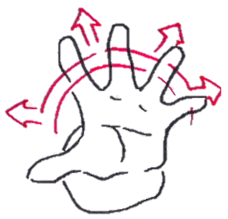
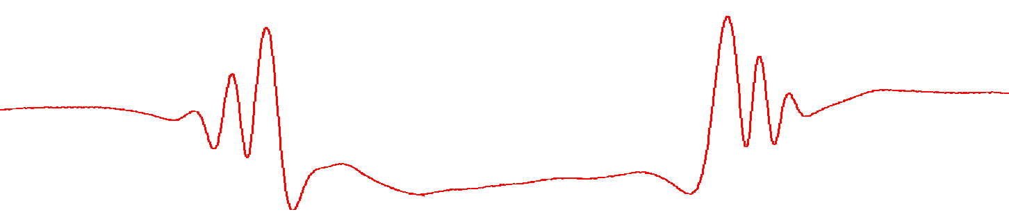
Solution: Amplitude Library of Gestures
Push versus Pull
Amplitude
Time

Slide 15
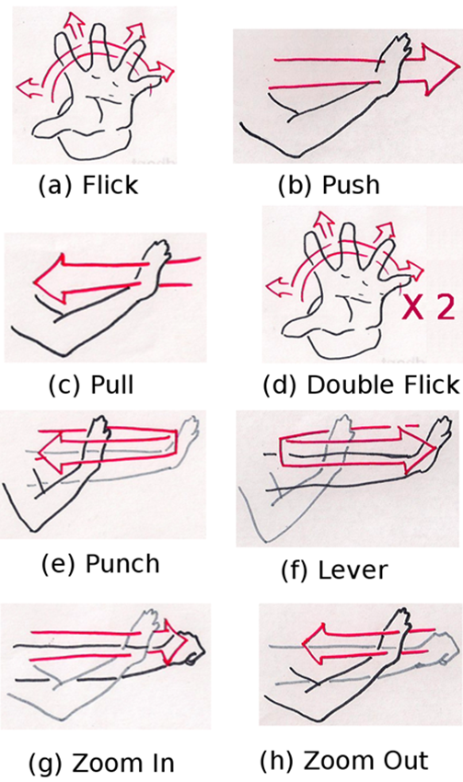
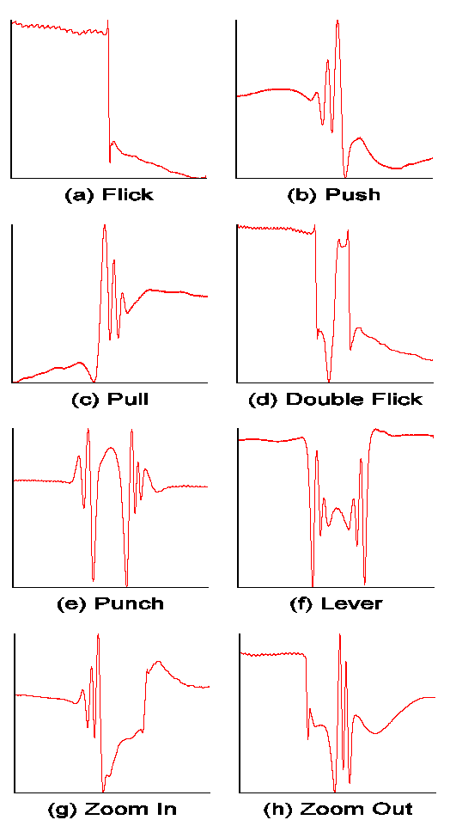
Generalizing to Multiple Gestures
Uses only add, shift, and compare operations

Slide 16
AllSee Hardware Architecture
Antenna
40 µW
RF Energy Harvester
Digital Logic
(MSP430)
Wireless
Receiver
1 mW

Slide 17
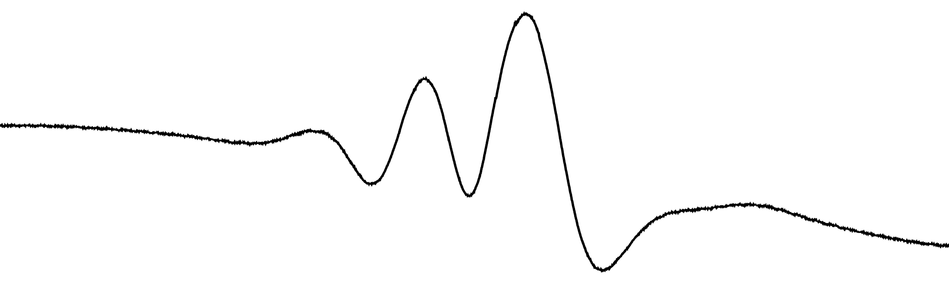
Solution: Optimize AllSee’s Workflow
Sleep
Sampling
Detection
Classification
System power consumption: 30 µW
Response Time: 80 µs
200 Hz

Slide 18
Evaluation

Slide 19
Classification Accuracy
5 Participants
8 Gestures
20 Repetitions
Total 800 Gestures
0.25% not detected
94% correctly classified

Slide 20
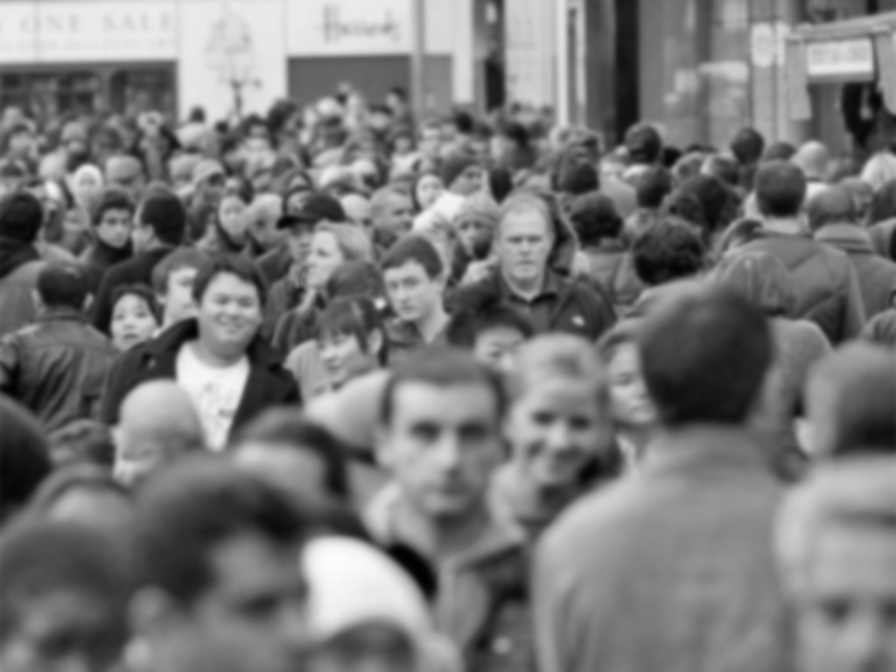
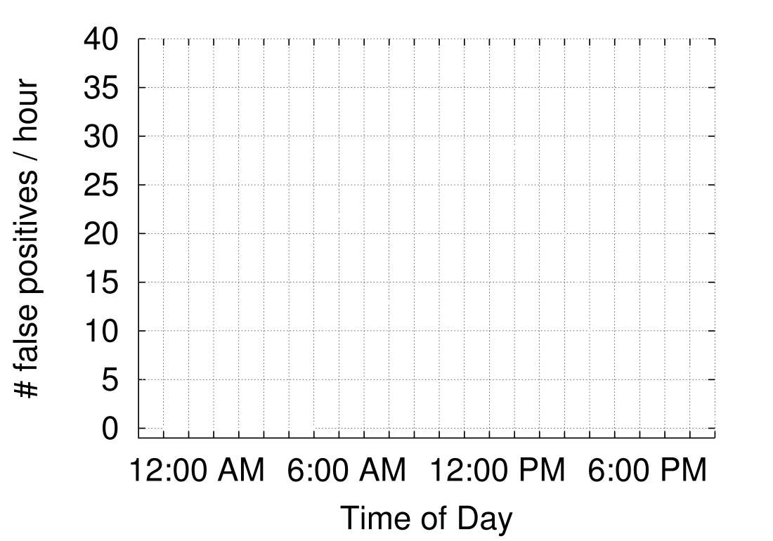
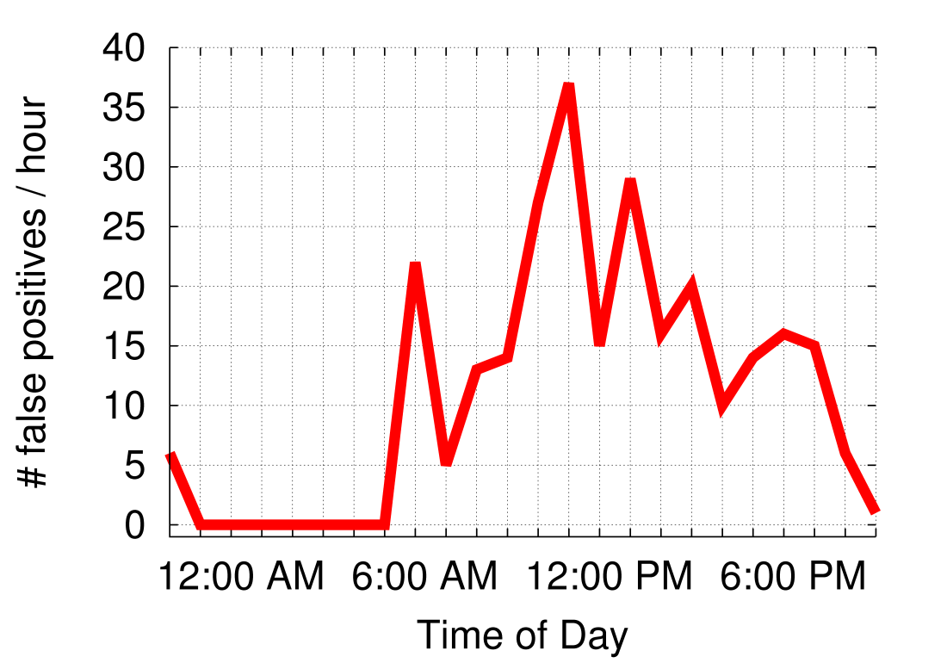
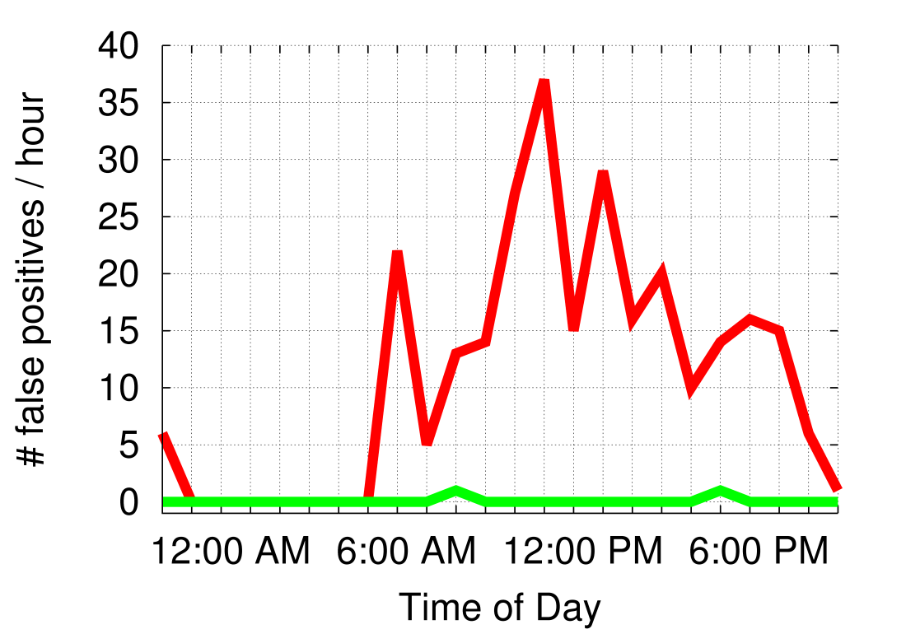
False Positives
Measured over 24 hours while 12 people share the workspace
11.1 per hour
Start: 0.083 per hour

Slide 21
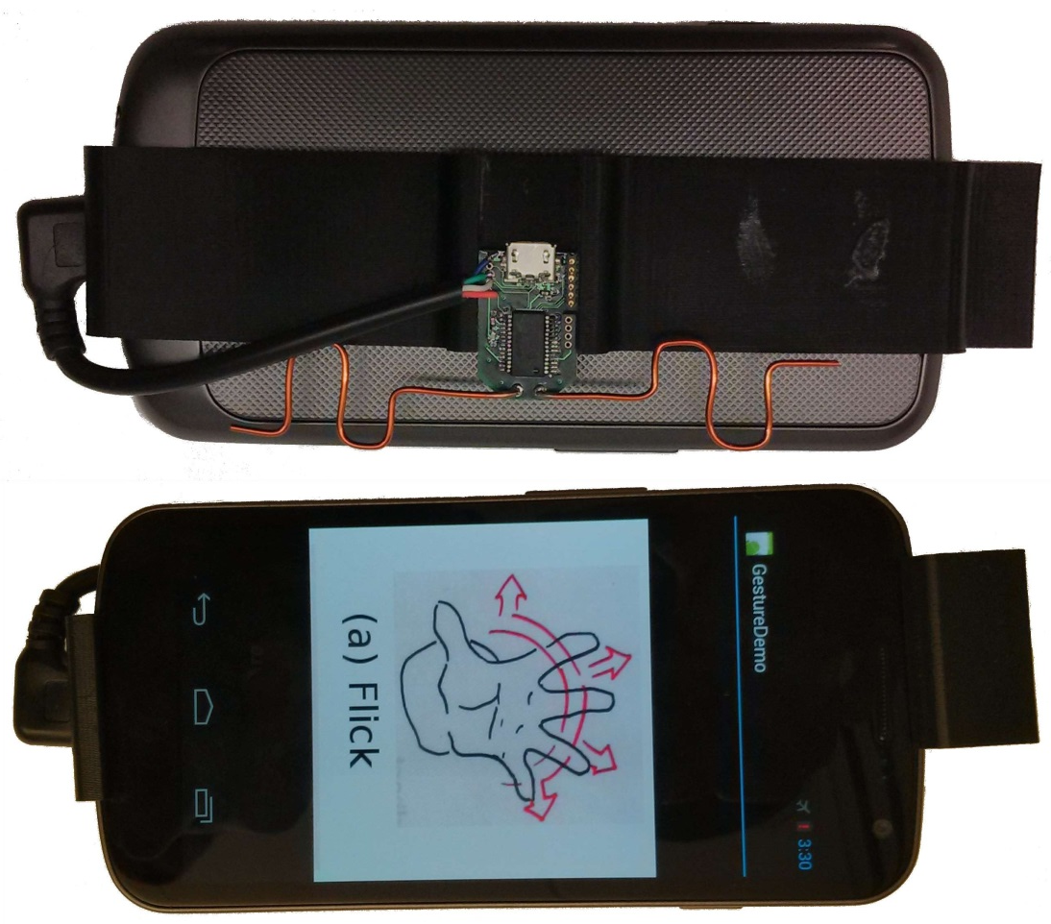
Through the Pocket
90% correctly classified

Slide 22
Conclusion
First gesture system that runs without batteries
Leverages ambient TV and RFID signals
3 – 4 orders of magnitude less power

